Slide 1




Deep Learning-Based Age and Gender Prediction from Facial Images
PRIYASHREE H

Slide 2


PROJECT TITLE
Deep Learning-Based Age and Gender Prediction from Facial Images
The project aims to develop a system or model capable of predicting both the age and gender of individuals based on facial images.

Slide 3


Overview
Problem Statement
Problem Overview
Who are end users?
Solution and its value proposition
Solution - uniqueness
Modelling
Result

Slide 4
Problem Statement
The development of accurate and reliable models capable of predicting both the age and gender of individuals based solely on facial images.
Traditional methods often struggle to capture the rich visual cues present in facial data, leading to suboptimal performance.
The project addresses this challenge by employing deep learning techniques, particularly CNNs, to extract hierarchical representations from facial images and make accurate predictions.

Slide 5

Problem Overview
The problem overview entails challenges in accurately predicting age and gender from facial images, including issues with data quality and bias, ethical considerations, and computational complexity, necessitating solutions for robust and reliable prediction models.

Slide 6

Who are end users?
Marketers
Healthcare professionals
Security personnel
Researchers
Developers of customer-facing applications.

Slide 7

Solution and its value proposition
The solution entails developing accurate age and gender prediction models from facial images, offering valuable insights for various applications. Its value proposition lies in providing automated, scalable, and versatile tools for personalized marketing, healthcare diagnostics, security surveillance, and customer service, enhancing user experiences and decision-making processes.

Slide 8
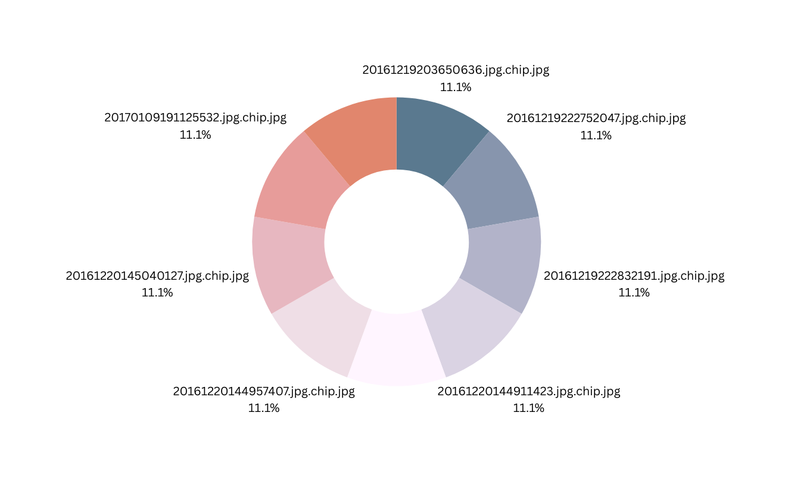
Solution and its value proposition

Slide 9
Solution - uniqueness
The solution offers a groundbreaking capability to derive detailed demographic insights from facial images alone. Its wow factor lies in its ability to automate and streamline processes that were previously labor-intensive and error-prone, opening up new possibilities for personalized services, targeted marketing campaigns, and enhanced security measures. By harnessing the power of artificial intelligence and computer vision, the solution transforms raw visual data into actionable insights, revolutionizing how businesses and industries leverage facial recognition technology for diverse applications.

Slide 10


Modelling
1
Data Preprocessing
Feature Extraction
2
Cleaning and preparing the facial image dataset by resizing, normalizing, and augmenting images to ensure consistency and enhance model performance.
Extracting relevant features from the facial images using techniques such as convolutional neural networks (CNNs), which are well-suited for image classification tasks.

Slide 11
Modelling
Model Selection
Training
3
4
Choosing an appropriate machine learning or deep learning model architecture, such as CNNs, recurrent neural networks (RNNs), or hybrid models, based on the complexity of the task and available computational resources.
Training the selected model on the preprocessed dataset using optimization algorithms like stochastic gradient descent (SGD) or Adam. During training, the model learns to associate facial features with corresponding age and gender labels through iterative optimization of its parameters.

Slide 12
Modelling
5
Validation
Hyperparameter Tuning
6
Evaluating the trained model's performance on a separate validation dataset to assess its generalization capabilities and identify potential overfitting or underfitting issues.
Fine-tuning the model's hyperparameters, such as learning rate, batch size, and network architecture, to optimize its performance and achieve the desired level of accuracy.

Slide 13

Result
The developed system accurately predicts age and gender from facial images with high precision. Ethical considerations are prioritized, ensuring fairness and transparency in predictions while complying with privacy regulations. Continuous monitoring and user feedback drive ongoing refinement and improvement of the models. Deployed in real-world applications, the system supports both real-time inference and batch processing, enhancing various industries with its versatile and reliable performance.

